Slide 1

Developing a High Level Preservation Strategy for Virtual Reality Artworks
Tom Ensom & Jack McConchie
No Time To Wait 3, BFI, London
23 October 2018
Supported by Carla Rapoport, Lumen Art Projects Ltd.
Notes:
This presentation is part of a project at Tate, supported by the lumen foundation to develop a High level preservation strategy for VR artworks.

Slide 2
Introduction
Moving from exploratory research to strategy for acquisition and preservation
First stages of project have explored:
The core components of VR systems (software and hardware) and their relationships
Production and playback of 360 video VR works
Production and playback of real-time 3D VR works
Initial exploration of preservation strategies for both the above
PASSIVE
EXPERIENCE
INTERACTIVE EXPERIENCE
360 Video
Real-Time 3D
Notes:
The aim of this ongoing project is to move from exploratory research towards a strategy for acquisition and preservation. This presentation aims to summarise our progress so far, which has been an examination of the:
THe core components of VR systems
The production and playback of 360 video VR works
THe production and playback of real time 3D VR works. It was increasingly apparent that there was a lot to understand before we could start the
exploration of preservation strategies for the above.
There are a range of experiences that people refer to as VR and we are focusing on 360 video and real time 3d.
We are talking about 360 video and real time 3D slightly separately as they present quite different characteristics- 360 video relies on pre rendered frames, whereas real time 3D is dynamically generated. This has repercussions for the level of interactivity- with 360 video we are tied to the point in space from where the video was taken, whereas real time 3D can be truly interactive. THis is reflected on this spectrum. On this you could also plot passive flat video way over on the left, and AR, which we have happily ignored so far. Because of the significantly different production processes and characteristics of 360 video and real time 3d, we’ve split them into two sections for this presentation.

Slide 3
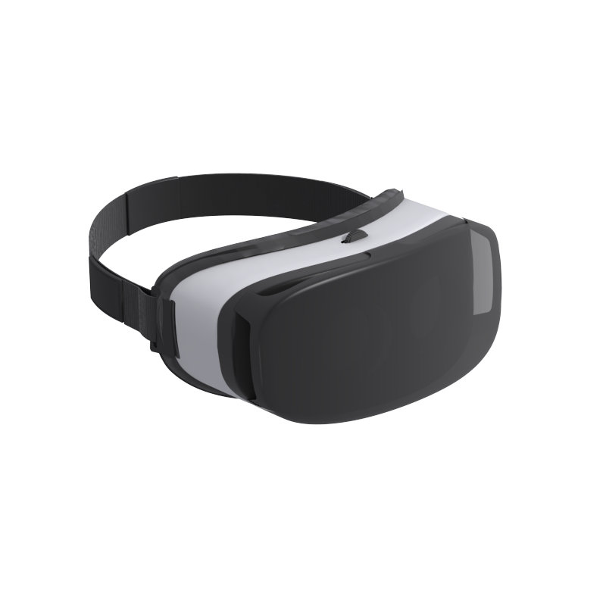


VR System Overview: Hardware
Controller
Headset
Computer System
Head Tracking System
User
Graphics Processing Unit (GPU)
Displays & Lenses
Positional Tracking System
Notes:
By way of starting, here’s a System overview.
This is a tricky diagram to explain, but what we wanted to show is that the user forms an important part of the system
The headset that the user is wearing is receiving the images generated by the computer, but is also monitoring the movement of the users head and feeding that back into the computer, determining what part of te image we see, what audio we hear etc.
There is also positional tracking, which uses a relationship between the headset and external sensors to generate a position within the physical space that the user is occupying.

Slide 4
VR System Overview: Software
Computer System
Operating System
VR Application
VR Runtime
Graphics Processing Unit (GPU)
Controller
Headset / HMD
Positional Tracking System
Notes:
Within the computer system there are a few important software components to highlight
The VR application is simply what, as conservators, we are interested in preserving - the bespoke software and associated data
This application communicates with the specialised VR hardware via what is known as a VR runtime, a software component usually provided by the manufacturer of the VR hardware used, which incorporates various APIs and drivers

Slide 5
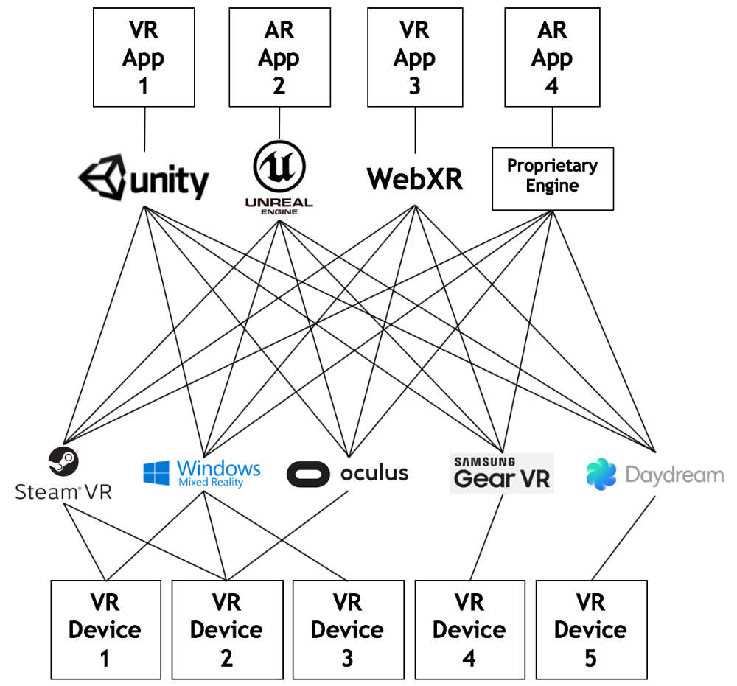
VR Platform Fragmentation
VR Application
VR Runtime
VR Headsets
& Tracking Systems
Image credit: Khronos Group https://www.khronos.org/openxr/
Notes:
The position of these proprietary runtimes as the intermediary between a VR application and the hardware means that they control access
Commercial interests have created a situation where different applications may have support for many different runtimes, but runtimes will only support a smaller subset of hardware systems
As a result we are highly dependent on access to manufacturer specific runtimes for maintaining these systems
There’s work underway to standardise runtimes which I’ll come back to later
For now, over to Jack who’s going to talk about 360 video in more detail

Slide 6
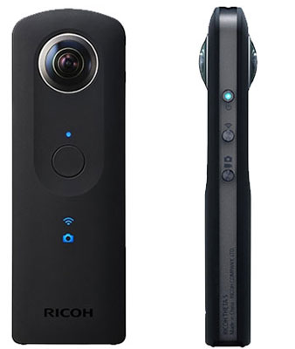
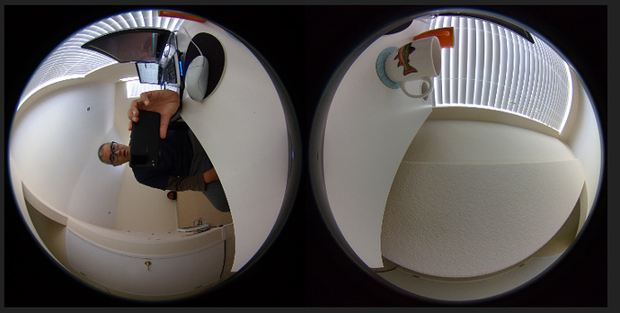
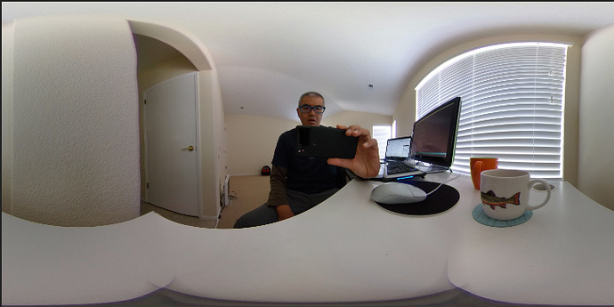
360 Video: Production
Capture: Monoscopic 360 with dual fisheye lenses
Image credit: http://theta360.guide/plugin-guide/fisheye/
Notes:
Having summarised the hardware and software systems, we’ll go on to outline the production and playback of 360 video and real time 3D.
For monoscopic video this is captured with two fish eye lenses, which is then stitched together into an equirectangular image. This can provide a 360 degree image but without depth information, since there is only one image for both eyes.

Slide 7
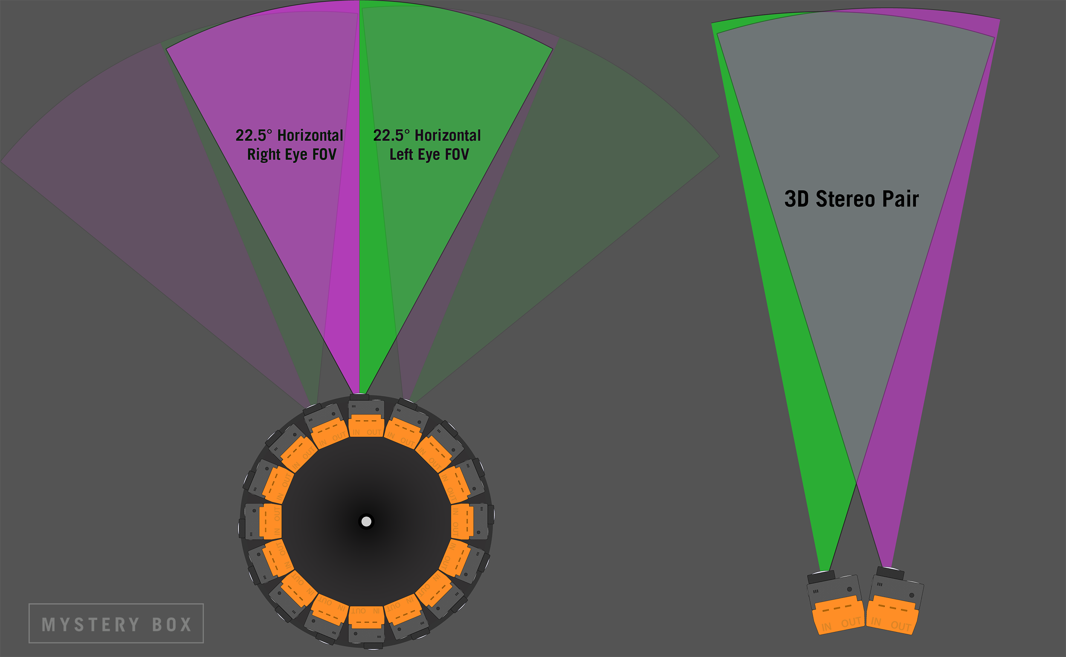
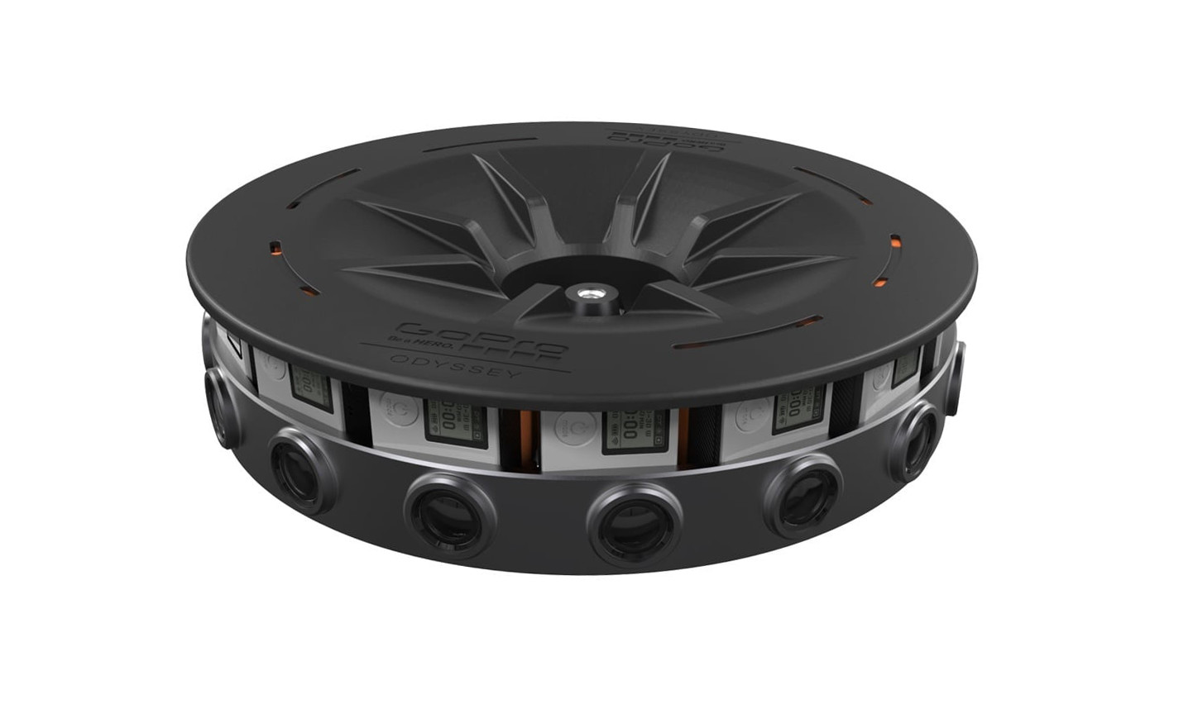
360 Video: Production
Capture: Stereoscopic 360 with multiple lenses
Image credit: https://www.mysterybox.us/blog/2017/1/31/shooting-360-vr-with-gopro-odyssey-and-google-jump-vr
Notes:
Stereoscopic 360 uses an array of lenses to generate a slightly different point of view for each eye- which when viewed back gives the impression of 3D.
In this diagram you can see that the image for the right eye is generated from the left most part of the right camera, whilst the image for the left eye is generated from the right most part of the left camera, giving us a 2 slightly different perspectives of the same scene.

Slide 8
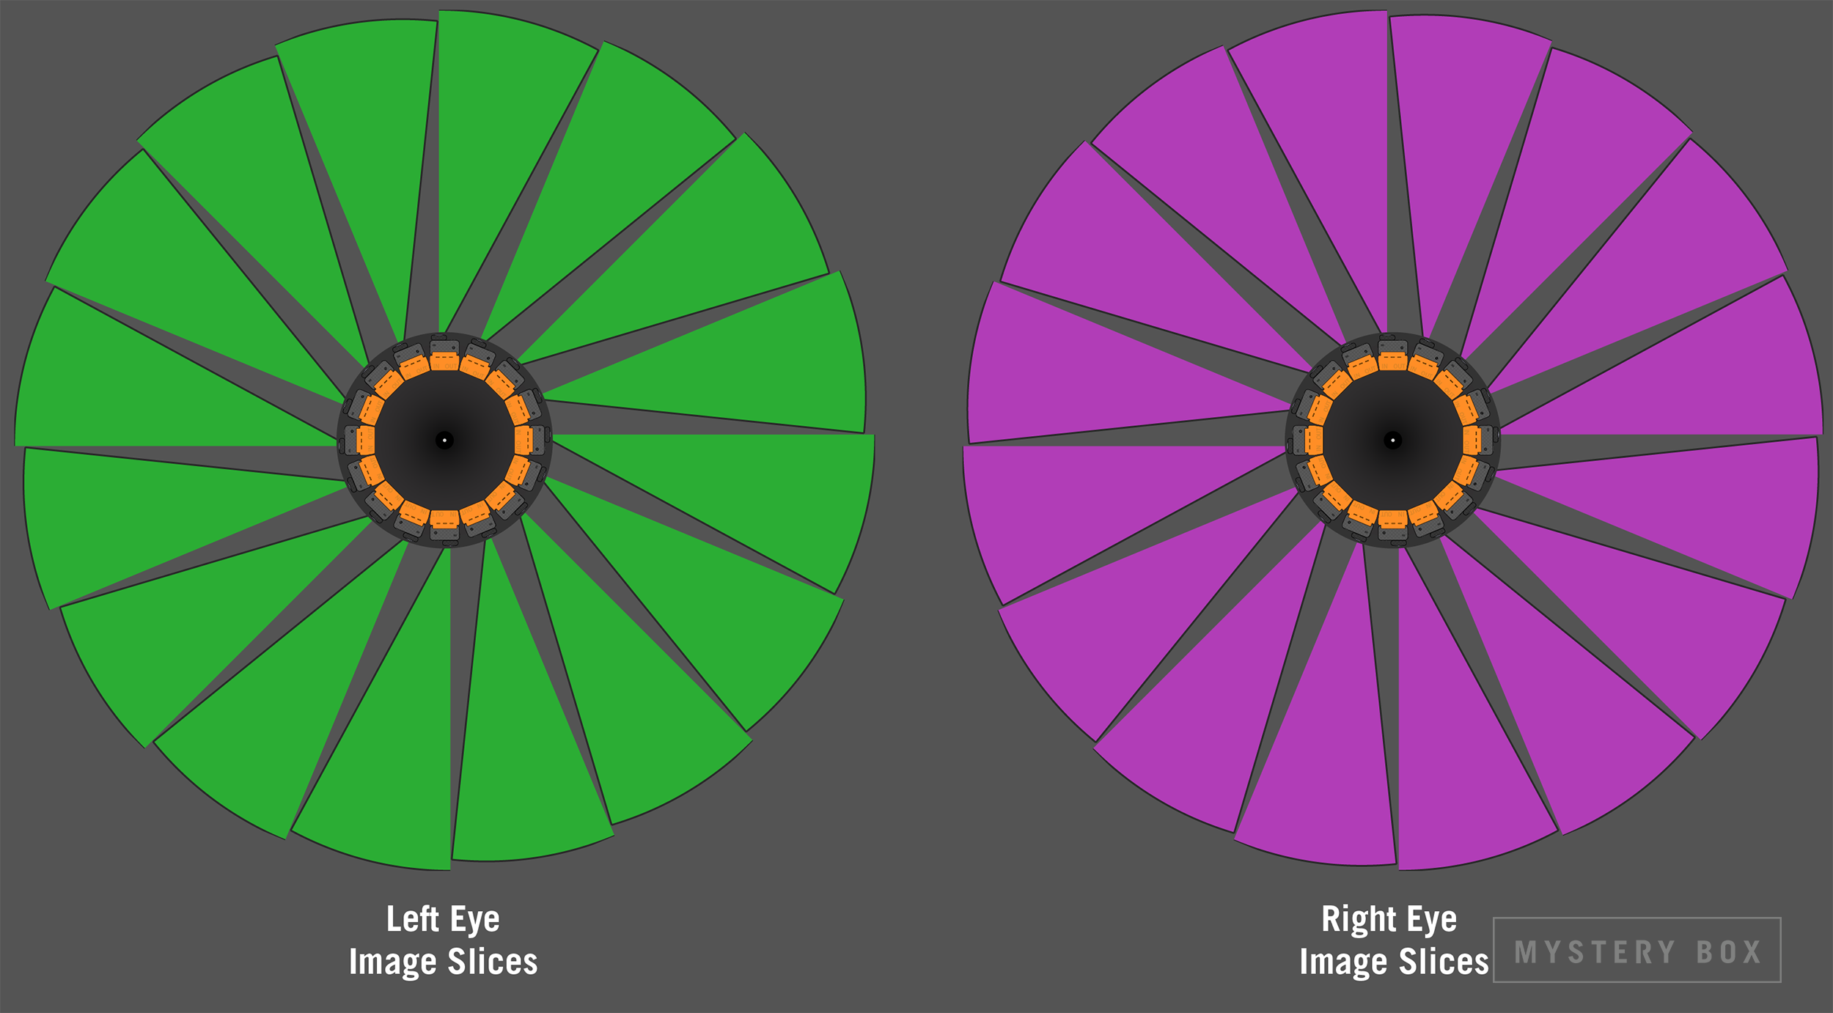
360 Video: Production
Capture: Stereoscopic 360 with multiple lenses
Notes:
In green all the left eye images are stitched together, and in purple all the right eye images are stitched together.
Once stitched, the information for each eye is stored in a rectangular frame with the media for each eye either top and bottom or side by side.

Slide 9
360 Video: Production
Common file characteristics
Containers | MP4, MKV
Aspect Ratio | Equirectangular 2:1
Frame rates | Commonly 60 fps
Resolution | 4096 x 2048- equivalent to 1024 FOV
Compression | H264, H265
Notes:
What files characteristics can we expect?
Containers are standard mp4, mkv etc
Aspect ratio of equirectangular is often 2:1 which covers 360 horizontally and 180 degrees vertically.
There is an importance of high frame rate- as your head moves from left to right, a low frame rate will become quickly apparent as lag in the image, and beyond looking bad this can also increase feelings of nausea. Commonly around 60fps.
Resolutions are high because of the 360 nature of the video- they need to contain a lot of information. When you take into consideration how much field of view your eye has within the environment, a 4k resolution would have the equivalent visible resolution of 1024. Therefore What would be considered a high resolution in flat video can look pretty low when viewed in VR.
H265 enables file sizes to be small- but at the price of computing overhead- which not all portable players can decode at the moment.
Therefore because of the variety of computational power and display resolution of the playback hardware, we can expect to see a few different permutations of these.

Slide 10
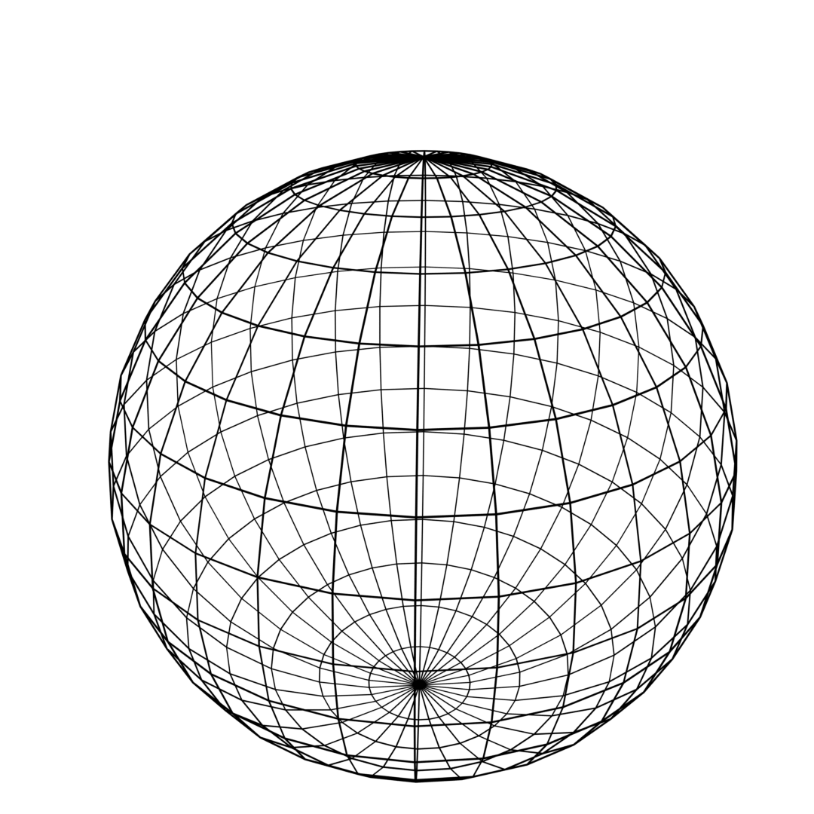
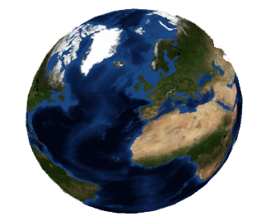
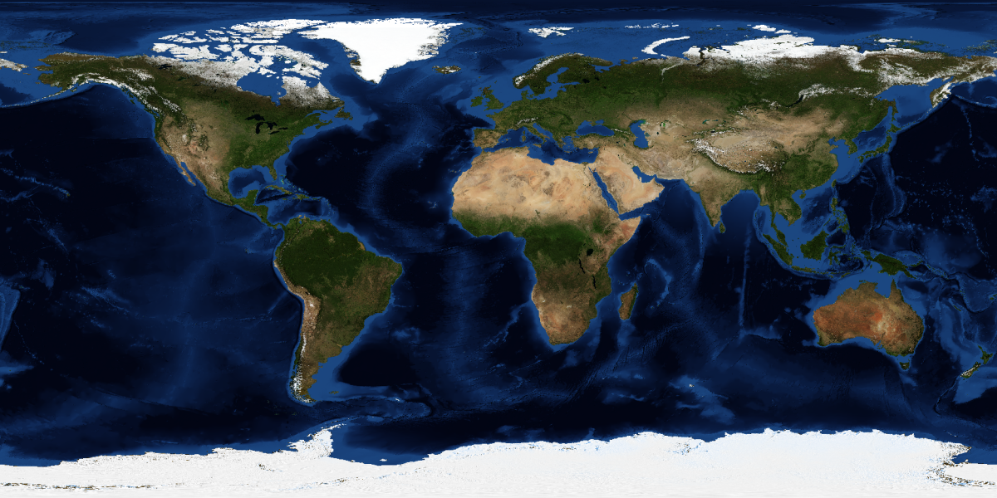
360 Video: Playback
Equirectangular
Equirectangular
Notes:
Playback
When we play back 360 equirectangular video, this is “projected” onto the inside of a 3d object that we are “inside” in the virtual space. It does this using a combination of a mesh and “UV map” which determines how the image is mapped onto the object. The players that do this are commonly based on 3D engines and that is something that Tom will talk about in more detail.
Equirectangular is a popular from of storage as it’s a very convenient form for editing in- fits nicely into a familiar rectangle.
Drawback Pixel density wastage- you can see that Antarctica has been stretched out along the bottom- using a disproportionately large area of the pixels.
The distorting of shapes in equirectangular also causes straight lines to be shown as curves, and this causes inefficiency in compression, since compression algorithms like to see motion vectors as straight lines and can apply temporal compression accordingly.

Slide 11
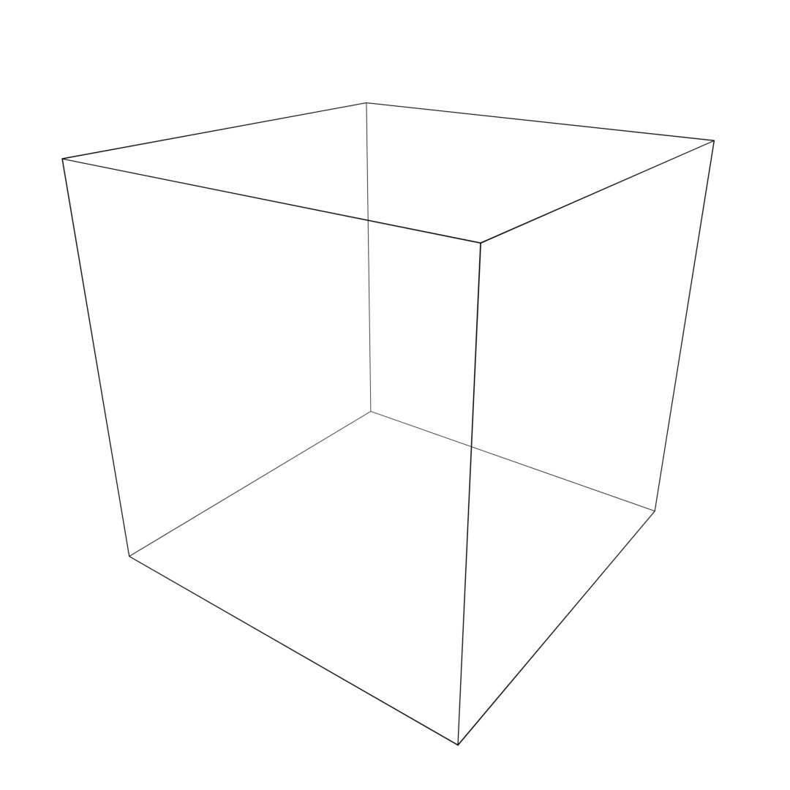

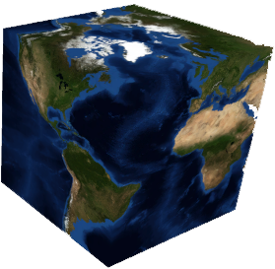
360 Video: Playback
Cubemap
Notes:
In response to these problems is the cubemap
All countries properly represented without distortion,
Straight lines are represented as straight lines therefore efficient for compression.
File sizes are approx 25% smaller for the same quality.
Remember that for stereoscopic we would have 2 x of these, one for each eye.

Slide 12

360 Video: Playback
Pyramid
Image credit: https://code.fb.com/virtual-reality/next-generation-video-encoding-techniques-for-360-video-and-vr/
Notes:
The are other evolving types used at the moment- an “equi angular cube map” that aims to distribute pixels more efficiently again within the cube map, and facebook is using a “pyramid” style projection where your field of view is represented by the base of the pyramid and the view behind you is represented by the remaining sides, all in the interests of reducing file size. This animation shows how 360 video is mapped onto a pyramid mesh.
The evolving use of different 3D shapes and mappings for 360 degree video playback points to the importance of archiving not only the video file, but also the 3D object and projection map alongside it. There is currently an open metadata scheme put forward by google that describes this, and provides a mathematical method by which you can extract the model mesh and projection map. It’s unclear how readily this will be adopted.

Slide 13
360 Video: Playback
Top bottom stereoscopic 360 equirectangular projection
Identifying string: “3dv” or “_tb”
examplemedia_3dv_.mp4
Left right stereoscopic 360 equirectangular projection
Identifying string: “3dh” or “_lr”
examplemedia_3dh_.mp4
Notes:
In the current absence of any widely adopted metadata, there is file naming convention that has been being used.
This uises a string of characters within the file name to describe the media.
This clearly isn't ideal given how easily a file name can be changed.

Slide 14
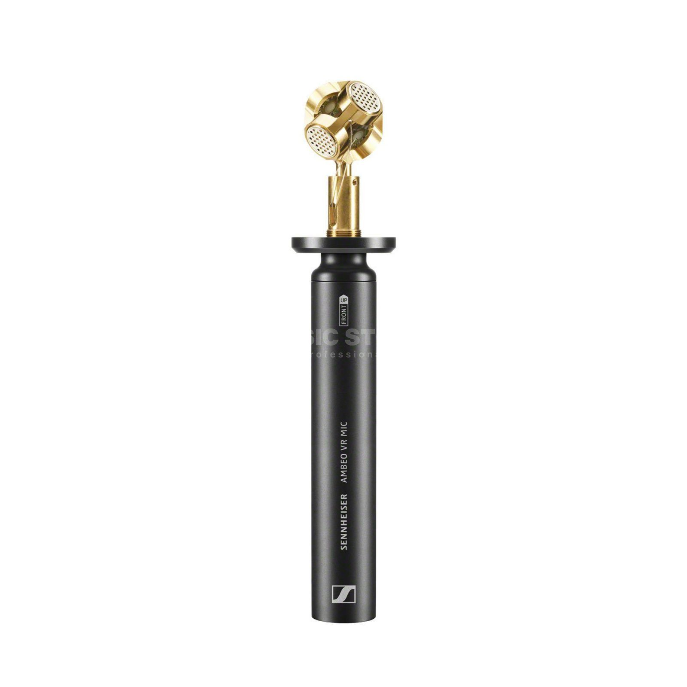
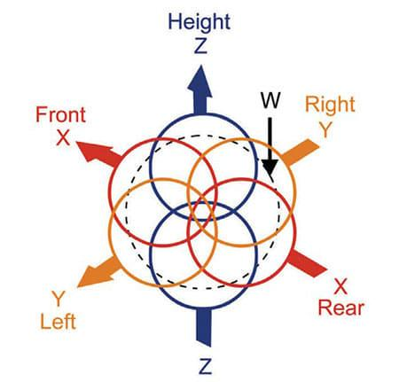
360 Audio: Production
“A” Format
Raw audio
“B” Format
Amplitude and spatial information
Notes:
What about the accompanying soundtrack?
If there is stereo sound then this is handled in the normal way and wouldn’t be dynamic in playback.
But often 360 video is accompanied by ambisonic audio
The principle of ambisonics is that you record a 360 sphere of audio that lets the listener orientate themselves in that space. Hence as they turn their head, the audio would be processed to reflect that .
Here we’ll look at “first order”, which is common and uses 4 microphone capsules.
The raw output of the mic is described as “A format” - a channel of audio for each capsule therefore 4 channels.
Using data from the microphone manufacturer, this is converted into a useable form called B format which again is 4 channels but now represents overall amplitude (the volume from all capsules added together) plus information on “front to back” in one channel, left to right in another, and up and down in another .

Slide 15
360 Audio: Production
Audio encoding | WAV, AIFF, AAC
Ambisonic “order” or number of channels | 4, 9, 16
Audio channel ordering | Furse-Malham, ACN
Audio channel spherical normalisation | SN3D, maxN, N3D.
Notes:
For audio, the channels can be ordered according to the FuMA or ACN conventions, and the spatial normalisation can be according to SN3D, maxN or N3D.
Again, the various permutations of these highlights the need for a metadata scheme suitable to describe them, and there are media metadata injection tools that are accommodating this and a proposed open scheme.

Slide 16

360 Audio: Playback
Direct sound
Filtered sound through head delayed
Diffracted sound around head delayed
Notes:
Our B format contains 360 audio, but in an abstract form. To decode the ambisonic audio, the player uses something called a HRTF or Head related transfer function.
This uses rotational tracking information from the headset to simulate where the virtual listeners head would be in the 360 degree sound field and calculates what you would hear in each ear, taking into consideration that you are not only hearing direct sound eg in your left ear, but also a filtered and diffracted version of that sound in your right ear. This varies from person to person, based on head size, ear position etc, so the player has to calculate this audio based on a data set that describes the average human head. All of these calculations are performed in real time even as move your head.
The reliance on the player in performing this calculation leads us nicely onto TOM..

Slide 17

Real-Time 3D: Production
Assets created using various proprietary and open-source tools and brought together in an engine
Assets typically portable with open file format potential in some cases:
3D models: meshes and materials
Textures: texture maps (raster images)
Sounds: Ogg Vorbis and WAV
glTF as open standard for archiving?
glTF succeeds Collada as an open spec file format for 3D asset/scene
Notes:
Real-time 3D virtual reality involves the rendering of frames on-the-fly - so not predetermined frames like video, but rather the technology of video games
The environments we experience in real-time 3D VR are built using 3D assets which are brought together in a 3D engine
Assets are the things that fill the virtual environment - the 3D models, the textured mapped over their surface, the sound effects
Assets usually have their own tools and workflows independent of a game engine
A huge number of file formats are utilised - mostly proprietary
glTF is a promising open standard although not yet widely adopted - open question

Slide 18
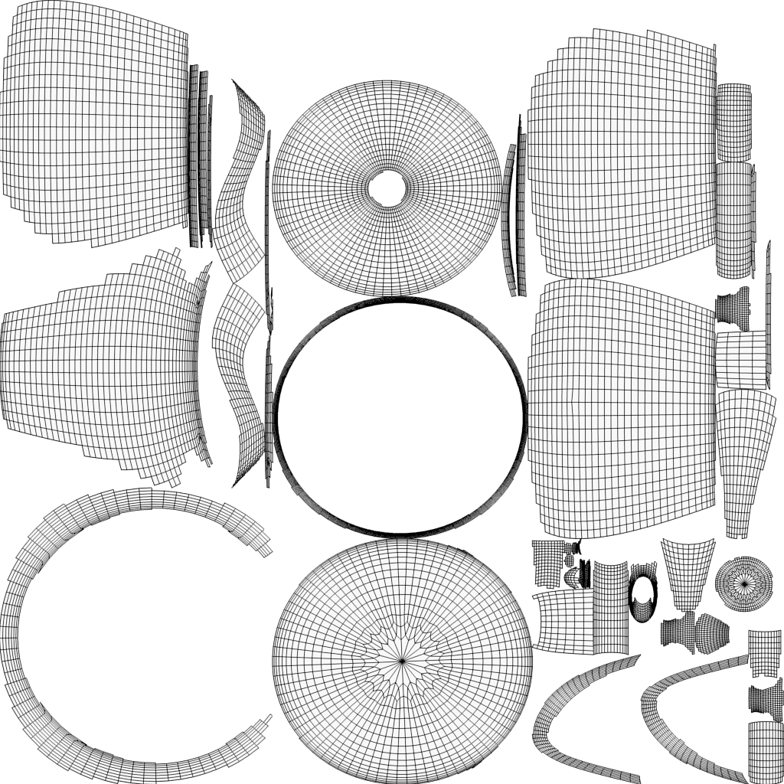

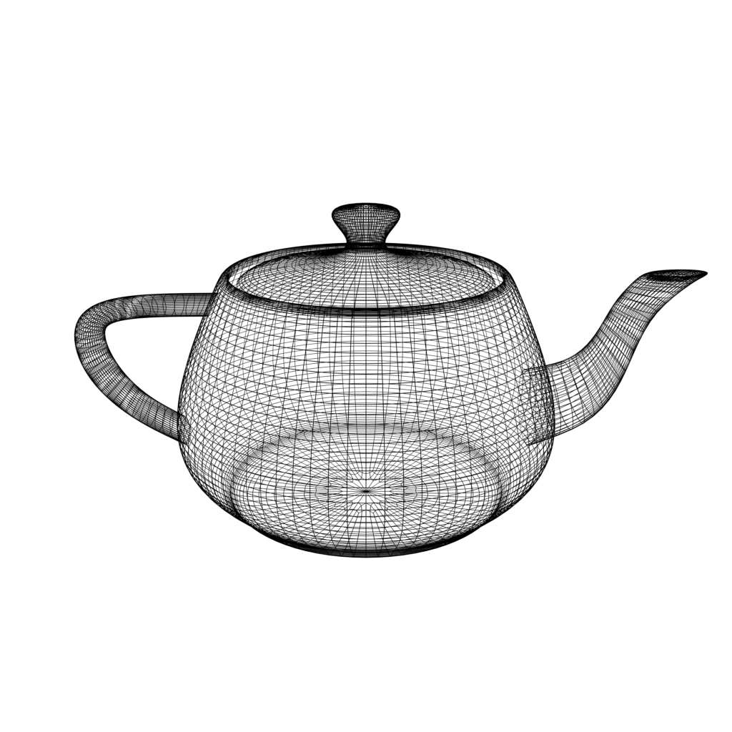


3D Modelling: Meshes and UVs
+
Mesh
UV Map
Notes:
3D models are the objects that fill the virtual space
A 3D model is at its core a combination of:
A mesh which is a representation of the structure of the surface of the model
A UV map which describes how texture data should be projected over the mesh - which also ties into to the 360 video project Jack mentioned earlier
May also incorporate animation data
Very variable workflow with many tools available, some proprietary some open source, with a wide variety of associated file formats

Slide 19








3D Modelling: Materials and Textures
Diffuse map: color
Normal map:
surface features
Metallic map: metallic (white)
non metallic (black)
Roughness map:
roughness (white)
smoothness (black)
Notes:
A model might also be associated with a material
A material is a set of texture maps and a shader (a small graphics program) which together describe the way in which the surface of a model reacts to light
In modern physically based rendering, this can incorporates many layered maps describing different characteristics
Again these maps can be produced in various ways but are typically stored as uncompressed raster images

Slide 20




Real-Time 3D: Production
Engines typically non-portable and proprietary/licenced
Engines integrate assets and engine features in scenes/levels and include:
Lighting
Material shaders
Physics
Visual or typed scripting
Sound engine
Plugins and extensions
Notes:
Assets are brought together in an engine, which is a complex program for constructing 3D scenes
They implement things like lighting, materials, scripting, sound mixing and also integrate with the VR runtime
Engines can often also be extended in various ways using plugins
As Jack mentioned earlier, these engines are also used as the basis of ‘players’ for 360 video - meaning the players are essentially compiled real-time 3D rendering software
Engines are typically proprietary and licenced, and unlike the assets which are somewhat portable, moving a whole 3D environment between engines would be challenging
Unity and Unreal are the big two at the moment and both support VR applications, but there are many others
Both have accessible source code repos with restrictive licence conditions

Slide 21
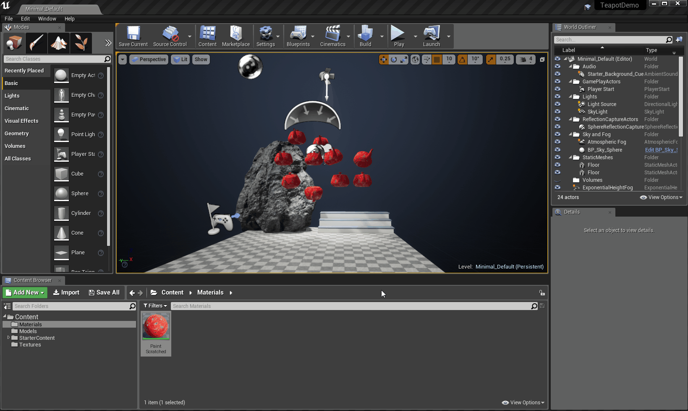
Screenshot of Unity/UDK
Notes:
Working with an engine today usually looks something like this - this is Unreal Engine 4
You get a kind of visual interface which allows you to manipulate the scene through this viewport
Assets are imported, arranged and lit
Cameras and scripting are added to create dynamic scenes and interaction
Finally, everything can be packaged as software for playback

Slide 22

Real-Time 3D: Playback
Built as executable software package
Usually consists of executable file(s) and packaged assets
Can be executed in a specific technical environment which might include:
VR Runtimes e.g. SteamVR, Oculus Runtime, OpenXR, WebVR etc.
Graphics API e.g. DirectX, Metal, OpenGL, Vulkan etc.
Graphics Processing Unit (GPU) and driver
Vulkan is an open standard for cross-platform 3D graphics which succeeds OpenGL
Notes:
Ultimately, real-time 3D production processes result in software: a variable mix of compiled low-level code and packaged data assets
As such we’re not dealing with file formats in the typical sense
Software is usually built for a particular machine type and the main consideration for consistent playback is how the software connects with its execution environment
The layers can be conceived of as:
VR runtime which handles communication between the VR hardware and the host system - currently largely proprietary - will return to this
Graphics API which handles communication between the graphics card the host system - again often associated with a particular operating system developer, but support for Vulkan is growing and this is a cross-platform and open standard
GPU which carries out the graphics math and is associated with a manufacturer specific drivers

Slide 23
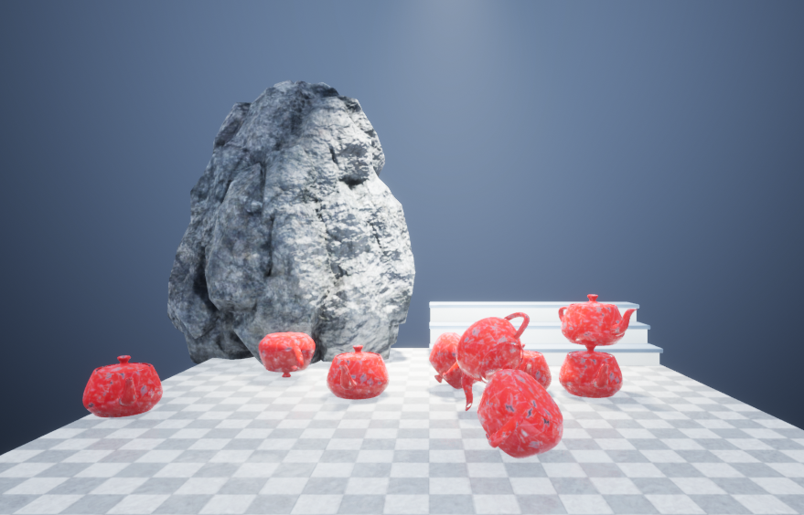
Rendering Pipeline
Geometry
Vertex Shaders
Textures
Fragment / Pixel Shaders
Vertex Processing
Rasterization
Pixel / Fragment Processing
Post Processing
Rendered Frame
Notes:
When running a real-time 3D application, a process occurs which looks something like this
This takes us from the level geometry and other vertex data to a rendered frame
This varies depending on the graphics API used
Not going to go into detail on this, but we call this the rendering pipeline and what’s important is that different stages of the pipeline are programmable to achieve certain effects

Slide 24
VR Rendering Pipeline
Geometry
Vertex Shaders
Textures
Fragment / Pixel Shaders
Vertex Processing
Rasterization
Pixel / Fragment Processing
Post Processing
Rendered Frame
+ Lens Distortion
+ Timewarp / Spacewarp
Notes:
Pipeline for real-time VR is quite similar to that for other real-time 3D applications e.g. games etc. but also includes a couple of additional processes that we need to talk about: lens distortion and timewarp
These usually both occur at late stages of pipeline

Slide 25
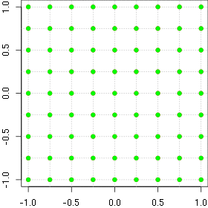
Lens Distortion
Lenses used in headset to achieve wide field of view at close range
Distortion must be corrected for in the frames send to headset
Usually carried out as post processing
Process specified by VR runtime
Image credit: Christian Pötzsch https://www.imgtec.com/blog/speeding-up-gpu-barrel-distortion-correction-in-mobile-vr/
Notes:
Lenses are used inside VR headsets to achieve a wider field of view at close viewing range to the embedded screens
In order to correct for the distortion these lenses introduce, the frames sent to the headset must be distorted
This means that in order to be displayed correctly in a particular headset the image is warped using a distortion algorithm specific to headset lenses
How this is done is specified by the VR runtime, and can be carried out at various points in the pipeline

Slide 26
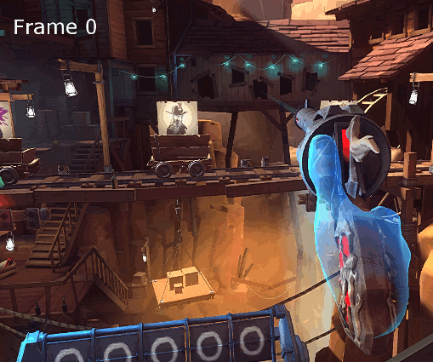
Timewarp & Spacewarp
Predictive interpolation of frames
Distorts previously generated frame based on movement of user and scene
Low cost tricks to maintain high framerate and low latency
Process specified by VR runtime
Image credit: Neo222 https://xinreality.com/wiki/Asynchronous_Spacewarp
Notes:
Timewarp and spacewarp are techniques used to maintain the high framerates required for VR, helping to achieve smoothness of motion and avoid motion sickness
These techniques generate extra frames by distorting the previously rendered frame based on the movement of the user and the scene
Doesn’t require the program to run through the whole rendering pipeline, so very efficient way to artificially raising framerate
Again, this is all handled by the VR runtime used

Slide 27
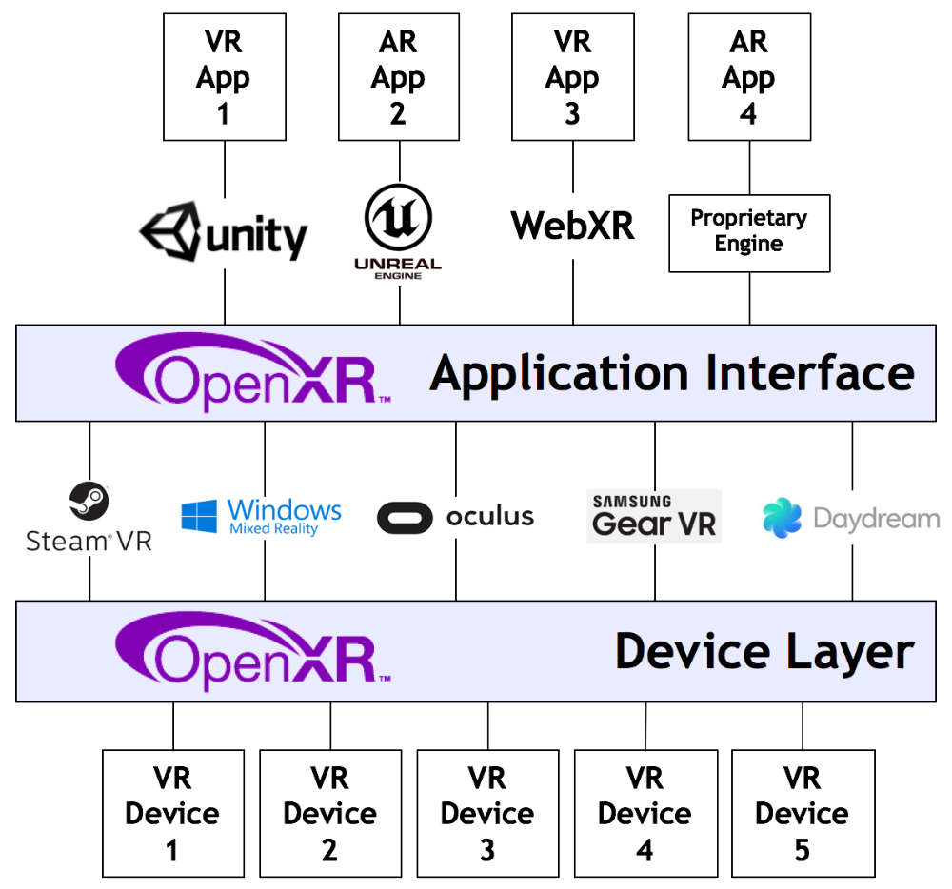
An Open Standard for VR Runtimes?
The Khronos Group is a consortium of industry partners who develop open standards for 3D graphics
OpenXR is working group attempting to develop a VR runtime standard
All the big players in the VR industry are involved
Like glTF and Vulkan, could also benefit preservation efforts… if it is adopted
Image credit: Khronos Group https://www.khronos.org/openxr/
Notes:
Given how important the VR runtime seems to be, losing access to this seems to be one of the primary risks for preservation
Fortunately work is underway which may help mitigate this risk
The Khronos Group is an industry consortium which focuses on the development of open standards for 3D graphics - OpenGL is probably their most widely adopted standard, but they are also behind glTF and Vulkan which I mentioned earlier
OpenXR is an attempt to develop a VR runtime standard
Currently in it’s very early stages, but brings together a lot of the big players in the VR industry
Promises to provide a generic, open interface between apps and runtime, and runtimes and devices
But will always be contingent on adoption, so we need to think about other options for stabilising these systems

Slide 28
Next Steps: Exploring Preservation Strategies
 | General | 360 Video | Real-Time 3D
Migration | Headset lens distortion algorithms | Moving between projection types Variability in players | How reliable are the open 3D asset standards Re-creating a 3D scene in different engines
Emulation | Emulating VR runtimes | Emulating 360 video players | Paravirtualization and passthrough for real-time 3D VR
Documentation | Field of view video capture Accounts of experience | Documenting projection type | 360 video capture
Notes:
So far we’ve had to spent time developing our understanding of these complex systems of production and playback
We’re interested in how we might apply existing preservation strategies to VR works
Overlaying existing preservation strategies onto our analysis of the systems has resulted in us identifying some key points of interest. We have identified individual tests to study feasibility of applying these approaches to VR and 360 video.
CSM
Outcome of these tests will inform not only a conservation strategy but also help us understand what to ask for during acquisition. These are just some tests that we have arrived at, and we welcome all of your input and feedback into these and the project as a whole.

Slide 29
Contact
Tom Ensom
tom.ensom@tate.org.uk
@Tom_Ensom
Jack McConchie
jack.mcconchie@tate.org.uk
@DataPotatoes

